Slide 1

EDA ON HOTEL BOOKING ANALYSIS
by
Chandan Prasad
Nikhil Solanki
Prerna Kashyap
Meet Dave
Lalith Kumar P S
(Cohort Enlighten)
CAPSTONE PROJECT 1
AlmaBetter

Slide 2
Problem Statement:
In this project we will be analyzing Hotel Booking data. This data set contains booking information for a City hotel and a Resort hotel along with information on various booking criteria such as booking season, pricing data, length of stay, number of adults, children and babies, parking spaces, market segment and many more.
Primary objective is to explore and inspect the dataset; and discover important features using Exploratory Data Analysis that can govern bookings and help hotels penetrate deep into market, thereby attracting more customers.
Secondary objective is help the customers in deciding best period to visit places while availing low accommodation cost benefits.

Slide 3
Work Flow :
We will divide our work flow into following 3 steps.
2. Data Cleaning
and Manipulation
Creating Data Frame
Understand the
columns
Analyzing data on the basis of demand, price, booking month, Year etc..
●
Data Collect and Understanding
Data Clenng and Manipulation
Exploratory Data Analysis(EDA)
Dealing with missing values
Creating new
columns
3. Exploratory Data
Analysis
1. Data Inspection

Slide 4
Data Exploration and Inspection:
Libraries imported:
Data manipulation: numpy and pandas
Data visualization : matplotlib and seaborn
Initial dataset size: 119390 rows and 32 columns.
Data contains following features:
hotel: Resort Hotel or City Hotel
is_canceled: Value indicating if the booking was canceled (1) or not (0)
lead_time: Number of days that elapsed between the entering date of the booking and the arrival date
arrival_date_year: Year of arrival date
arrival_date_month: Month of arrival date
arrival_date_week_number: Week number of year for arrival date arrival_date_day_of_month: Day of arrival date
stays_in_weekend_nights: Number of weekend nights
stays_in_week_nights: Number of week nights.
adults: Number of adults
children: Number of children
babies: Number of babies
meal: Type of meal booked
country: Country of origin.

Slide 5
Data Exploration and Inspection:
market_segment: Market segment designation (TA/TO)
distribution_channel: Booking distribution channel.(T/A/TO)
is_repeated_guest: is a repeated guest (1) or not (0)
previous_cancellations: Number of previous bookings that were cancelled prior to the current booking
previous_bookings_not_canceled: Number of previous bookings not cancelled by the customer prior to the current booking
reserved_room_type: Code of room type reserved.
assigned_room_type: Code for the type of room assigned to the booking.
booking_changes: Number of changes made to the booking
deposit_type : No Deposit, Non Refund , Refundable.
agent: ID of the travel agency that made the booking
company: ID of the company/entity that made the booking .
days_in_waiting_list : Number of days the booking was in the waiting list before it was confirmed to the customer
customer_type: type of customer. Contract, Group, Transient, Transient party.
adr: Average Daily Rate as defined by dividing the sum of all lodging transactions by the total number of staying nights
required_car_parking_spaces: Number of car parking spaces required by the customer total_of_special_requests: Number of special requests made by the customer (e.g. twin bed or high floor)
reservation_status: Reservation last status.

Slide 6
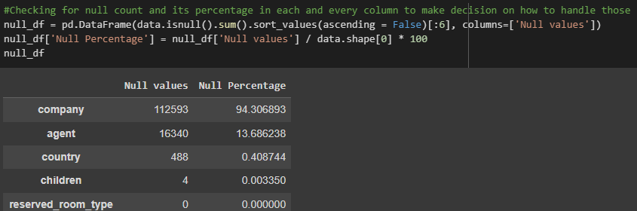
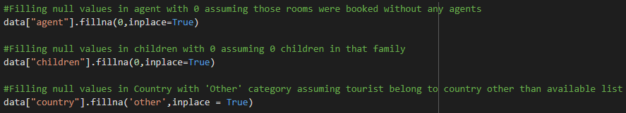
Data Cleaning and Manipulation:
I. Handling Null values: Columns company, agent, country and children

Slide 7
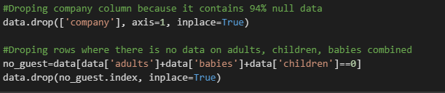
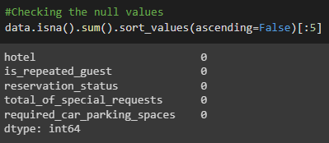
Data Cleaning and Manipulation:
II. Dropping irrelevant columns and rows

Slide 8
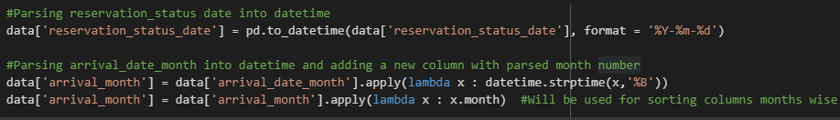
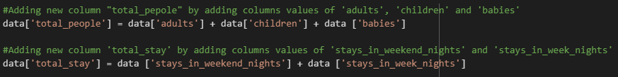
Data Cleaning and Manipulation:
III. Parsing date in string to Datetime format
IV. Feature Engineering
‘total_people’ = total of adults, children and babies
‘total_stay’ = total of weekend nights and weekdays nights

Slide 9
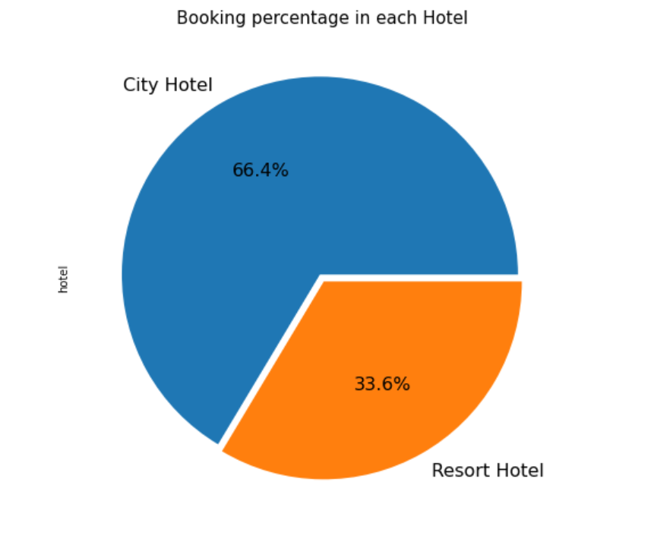
Exploratory Data Analysis (EDA):
Booking percentage of different type of Hotels
INFERENCE:
Majority of the guest prefer City Hotel over Resort Hotel
2/3rd of total guest prefer City Hotel

Slide 10
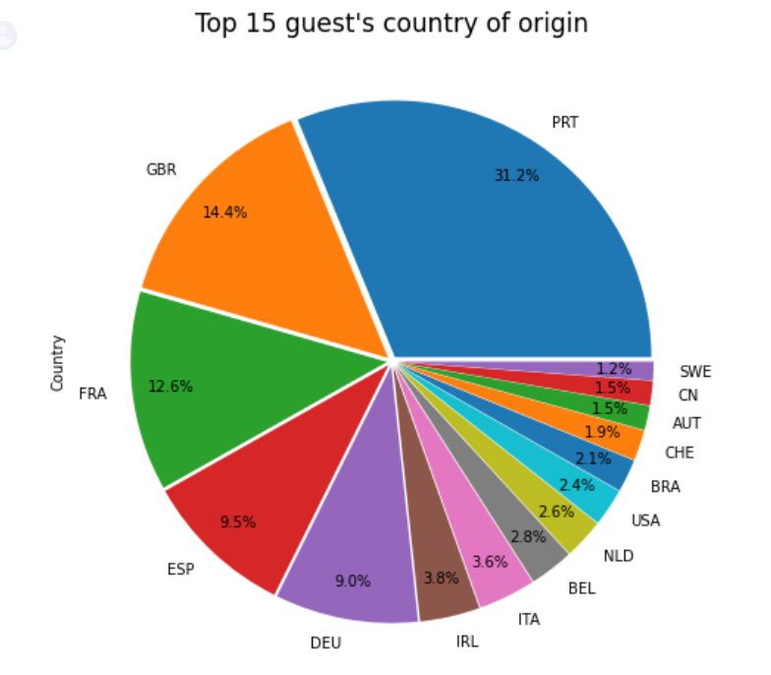
Exploratory Data Analysis (EDA):
Home country of majority of guests
INFERENCE:
From plotted pie chart, its evident that most of guest visiting these City hotels and Resort hotels are from Portugal and other European countries namely Britain, France, Spain and Germany.

Slide 11
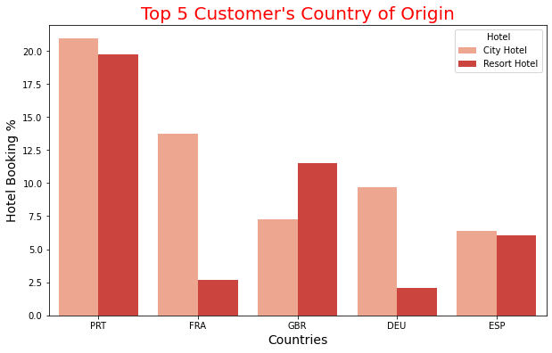
Exploratory Data Analysis (EDA):
Hotel preference of guest from Top 5 Countries
INFERENCE:
Guest from southern European countries like Portugal and Spain prefer City Hotel and Resort Hotel equally
Guest from northern European countries like France and Germany prefer City Hotel a lot more than Resort Hotel
Guest from Britain prefers lavish Resort hotels

Slide 12
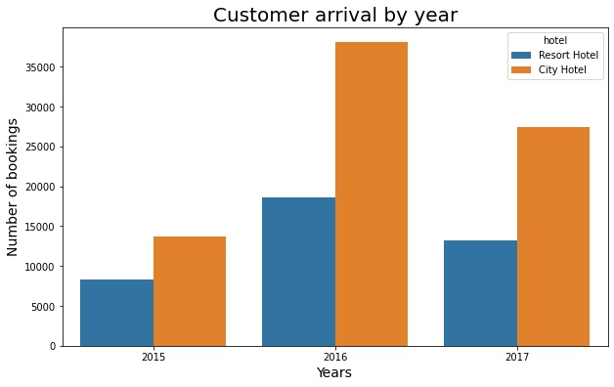
Exploratory Data Analysis (EDA):
Overview of guest's visit over different years
INFERENCE:
As we can see that 2016 was the year where number of hotel booking was highest followed by total booking in 2017 and 2015

Slide 13
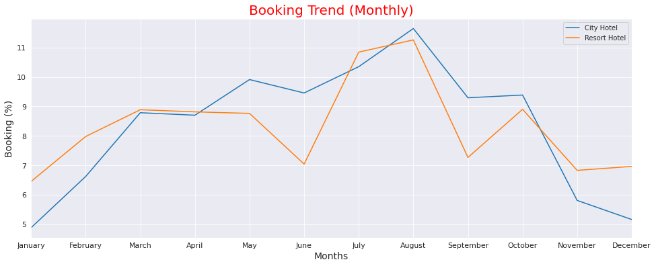
Exploratory Data Analysis (EDA):
Booking trend round the year
INFERENCE:
Peak visiting season is from mid June to August because of summer breaks in Europe
Off season is from November to February because of cold weather throughout Europe
Guests can consider visiting these hotels during month of June and September to enjoy decent weather with almost full availability of hotels accommodation.

Slide 14
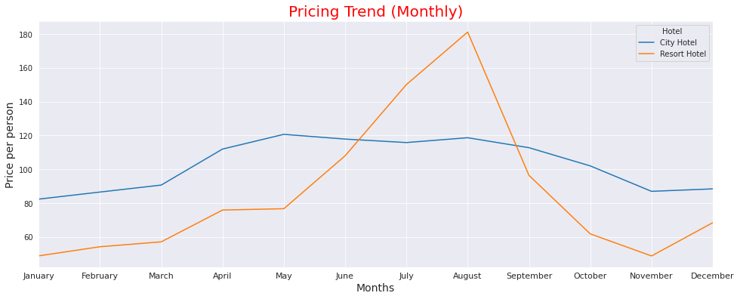
Exploratory Data Analysis (EDA):
Price trend round the year
INFERENCE:
Pricing trend is highly correlated with booking trend when it comes to Resort hotel
Pricing trend here indicates that during Peak season, price for Resort hotels is triple compared to off-season
Pricing trend for City hotels suggests almost same pricing throughout the year with bit of fluctuation during May to August

Slide 15
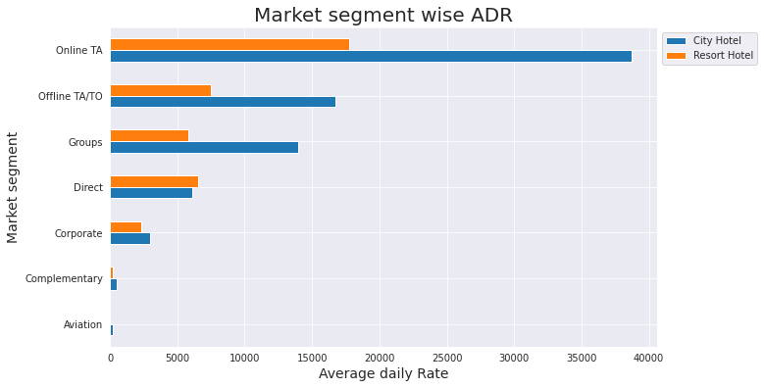
Exploratory Data Analysis (EDA):
Average booking rate of different Market Segments
INFERENCE:
As we can see, Resort hotel and City hotel are getting the most of booking from Online travel agency and may be in future it will be monopoly by them. Hence hotel owners should promote more in different market segments

Slide 16
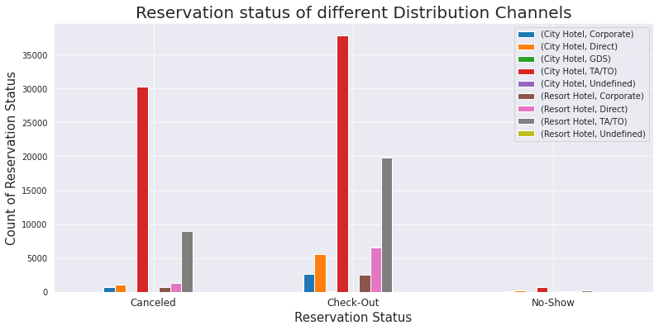
Exploratory Data Analysis (EDA):
Reservation status from different Distribution Channels
INFERENCE:
We can infer from above graph that Bookings and Cancellations from both Hotels are more from Travel agency (TA/TO)
Guest visiting both Hotels directly and via Corporate are less likely to cancel their booking
We can notice a very small proportion of guest booking via Travel agency not showing up at Hotel

Slide 17
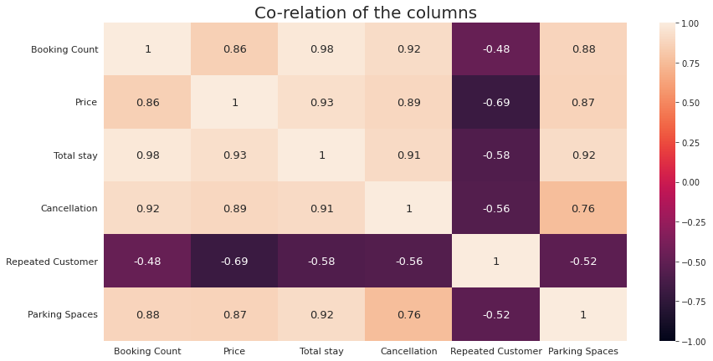
Exploratory Data Analysis (EDA):
Correlation between different booking criteria
INFERENCE:
There is high positive correlation between Booking, Pricing, Total Stay, Cancellations and Parking spaces where as negative correlation with Repeated guests
With increase in Booking → Pricing, Total stay and Parking spaces occupation increases but increase in Pricing also leads to repeated Customers not visiting again
There is firm correlation between Parking space and Cancellation inferring that people are more likely to cancel their booking if Parking space is not available.

Slide 18
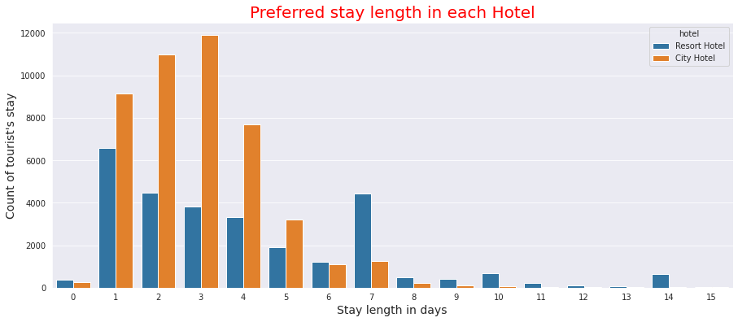
Exploratory Data Analysis (EDA):
Guest's stay length
INFERENCE:
Guest prefer 1-4 days when staying in City Hotels
Guest prefer 1-4 days when staying in Resort Hotels as well but 7 days stay is also popular choice among guests

Slide 19
Conclusion:
Majority (66%) of the guests prefer City Hotel over Resort Hotel. Most of guest visiting these hotels are from European countries namely Portugal, Britain, France, Spain and Germany totaling to 75% of total booking count.
Guest from southern European countries like Portugal and Spain prefer both hotels equally. Guest from northern European countries like France and Germany prefer City hotel nearly 10% more than Resort hotel. Guests from Britain prefers lavish Resort hotels nearly 5% more than Resort hotel. This indicated that people from different region of Europe prefer different type of accommodations and comforts.
2016 observed the highest booking reservations. From Booking trend its can be inferred that Peak visiting season is from mid June to August because of summer breaks in Europe while November to February is off season because of freezing cold weather throughout Europe.
Around 11.5% of total reservations throughout year are coming from August whereas January has the least reservation of mere 5%. Guests can consider visiting these hotels during month of June and September to enjoy decent weather with almost full availability of hotels accommodation.
Pricing trend is highly correlated with booking trend indicating that price for Resort hotels during peak season hikes to nearly 300% compared to off-season. Meanwhile, Pricing trend for City hotels suggests almost same pricing throughout the year with low fluctuation during busy period from May to August

Slide 20
Conclusion:
Inspecting different market segments, it was concluded that Online travel agency holds monopoly as both hotels are getting the most of booking from Online travel agency (around 79%). Hotel owners should consider promoting their hotels more in different market segments to penetrate market more.
Interestingly, most of the Cancellations for both Hotels are also from Travel agency (TA/TO) segment inffering that it is volatile market segment. Also, a very small proportion of guest booking via Travel agency do not showing up at Hotel. Guest visiting both Hotels directly and via Corporate are less likely to cancel their booking
There is high positive correlation between Booking, Pricing, Total Stay, Cancellations and Parking spaces whereas negative correlation with Repeated guests. With increase in Booking --> Pricing, Total stay and Parking spaces occupation increases but increase in Pricing leads to repeated Customers not visiting again.
There is firm correlation between Parking space and Cancellation inffering that people are more likely to cancel their booking if Parking space is not available.
Ideally guest prefer to stay 1-4 days in both hotels but 7 days stay at Resort hotel is also a popular choice among guests.

Slide 21
Signing off…
THANK YOU

